Slide 1
BSW and MSW International Opportunities
WEBINAR
Collaborations with:
SSW Field Education Office, Student Affairs, Advising, and Advancement Office AND Illinois Abroad and Global Exchange (IAGE), Il. International Safety and Security, & The Volunteer Adventure Corps (VAC)

Slide 2
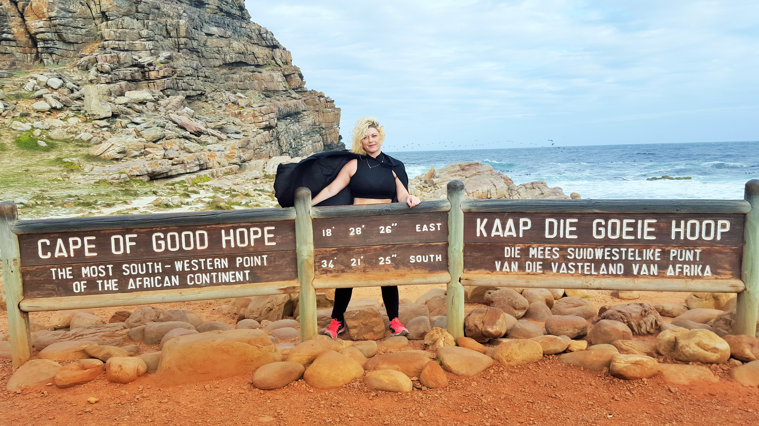
Welcome and introductions
2017 MSW student in Cape Town, SA

Slide 3
What will I learn today?
BSW and MSW Internships abroad all fall under the SSW Field Education (internship office) umbrella
BSW and MSW’s must meet all the same criteria for international internship preparedness as they would for in-country internships.
Hellen McDonald will work with students around international internships and study abroad.

Slide 4
What will I learn today?
BSW and MSW International internships currently are offered through two pathways:
Site-based, to Cape Town South Africa, with the Volunteer Adventure Corps (VAC) on ground, Spring, Summer and Fall semesters. 12 weeks.
Student-based, to other countries, usually their home countries.
Can be two-semesters for Traditional, MSW students and follow
the field education office timelines.

Slide 5
What will I learn today?
The Illinois Abroad and Global Exchange (IAGE) office is the University’s study abroad office.
IAGE is embedded administratively within the SSW.

Slide 6
What will I learn today?
IAGE oversees the online applications for the following programs and budgets:
Site-based pathway: BSW and MSW Internships to Cape Town, South Africa, and
Short-term, faculty-led programs (Greece and Brazil)

Slide 7
What will I learn today?
IAGE online Application for BSW/MSW Intern to Cape Town, South Africa – mystudyabroad.com ONE semester (12 weeks abroad)
BSW’s : Spring 2025 start internship. Application submission due by:October 1, 2024
MSW’s: Fall 2025 internship due by February 15th, 2025
Internship timeline and Placement details
Unofficial budget
Q&A

Slide 8
Short-term, Faculty-led study abroad program
BRAZIL 2025- NEW THIS YEAR!! BEING CONSTRUCTED AS WE SPEAK.
Apply through study abroad portal @studyabroad.Illinois.edu
*Deadline TBD: December 2024 - February 2025
When cleared, you will be able to register for SOCW 330 International Perspectives in Social Work: Brazil
Spring 2025 course offer
*This is a new program that is still being formulated. As soon as we have finalized the contract with Campus B, we will inform interested students and post deadlines.

Slide 9
Short-term, Faculty-led study abroad program
Tentative dates:
March 12-May 30th, 2025
Hybrid model offers students opportunity to join in this global classroom without leaving the U.S.
Remote option
March 12-May 18: USA. Weekly, 1.5 hr, online classes, global virtual classroom includes Brazilian students, social justice lens; bilingual (no Portuguese language proficiency required for Illinois students and no English language proficiency required for Brazilian students.

Slide 10
Short-term, Faculty-led study abroad program
Tentative dates:
March 12-May 30th, 2025
Hybrid model offers students opportunity to join in this global classroom without leaving the U.S.
On-site in Brazil:
May 19-May 28th: Brazil
May 29-30th: virtual debriefing

Slide 11
Short-term, Faculty-led study abroad program
Campus B is the educational consulting vendor who coordinates this international opportunity with us
Https://campusb.org/about-us/
Your faculty co-leaders will be: Prof. Lili Windsor and Heather Jones, PhD candidate
Prof. Windsor is our SSW Professor and Associate Dean for Research, from Brazil and is excited to teach this class. Fluent in Portuguese.

Slide 12
Short-term, Faculty-led study abroad program
UNOFFICIAL SAMPLE COSTS for BRAZIL 2025 subject to change
Number of students: 12
Remote: $851
Hybrid with travel: $3,513
Number of students: 15
Remote: $685
Hybrid with travel: $3,205
Note: airfare, visa fees, passport fees, and other administrative costs, not included

Slide 13
Short-term, Faculty-led study abroad program
SAMPLE COSTS for BRAZIL 2025 (UNOFFICIAL)
Important to know:
Students do not contribute to co-leaders expenses whatsoever.
Campus B offers to cover one faculty free of charge.
The School of Social Work is covering second co-leader costs.
SSW scholarships are competitive. Range $500-$1500

Slide 14
BSW International Internships
Site-based model to Cape Town, South Africa (VAC)
BSW’s:
Inform your SOCW 461 Professor and add international internship interest to your internship planning document
Attend Field Day (September) and visit the SSW International Programs table
Attend an Info session like this one
Email hgmcdona@illinois.edu (Hellen McDonald) for individual planning meeting
Complete the IAGE online application (study abroad portal – future slides)

Slide 15
BSW International Internships
Student-driven model
Inform your SOCW 461 Professor and add international internship interest to your internship planning document
Attend Field Day (September) and visit the SSW International Programs table
Attend an Info session like this one
Email hgmcdona@illinois.edu (Hellen McDonald) for individual planning meeting

Slide 16
MSW International Internships
Site-based model to Cape Town, South Africa (VAC)
MSW’s:
Attend Field Day (September), Attend Field Day (September), visit SSW International Programs table, and include your international internship interest on your Field Application (in SONIA, October)
Email hgmcdona@illinois.edu (Hellen McDonald) for individual planning meeting
Complete IAGE online application

Slide 17
MSW International Internships
Student-driven model
Attend Field Day (September), visit SSW International Programs table, and include your international internship interest on your Field Application (in SONIA, October)
Email hgmcdona@illinois.edu (Hellen McDonald) for individual planning meeting
NOTE: you will not be completing the IAGE study abroad portal application

Slide 18
IAGE ONLINE APPLICATION
All prospective interns interested in the site-based model to Cape Town, South Africa, complete the:
Program application through My Study Abroad portal (studyabroad.Illinois.edu)
Deadline: October 1, 2024

Slide 19
IAGE
Illinois Abroad and Global Exchange (IAGE)
In the portal, find:
BSW/MSW: Study and Intern in South Africa
https://app.studyabroad.illinois.edu/index.cfm?FuseAction=Programs.ViewProgramAngular&id=11062

Slide 20
IAGE ONLINE APPLICATION: BSW’s to Cape Town, SA – FALL 2024
My Study Abroad portal: studyabroad.Illinois.edu
Program is open to applications for BSW/MSW Study and Intern in South Africa:
BSW Spring 2024 start: Deadline is October 1, 2024
Complete all questions/upload copy of passport or copy of receipt of passport application
Two email addresses of faculty/advisors references. Email will be sent to your references through the application system; references will complete a short questionnaire

Slide 21
IAGE ONLINE APPLICATION: BSW’s to Cape Town, SA – FALL 2024
My Study Abroad portal: studyabroad.Illinois.edu
Program is open to applications for BSW/MSW Study and Intern in South Africa:
BSW Spring 2024 start: Deadline is October 1, 2024
Best candidates to be your reference:
Your professors whose classes you have taken and whom you have checked in with, informed them of your strong interest to study abroad, and can speak to your academic strengths, or
Your academic advisors.
NOTE: your current SOCW 461 internship faculty with whom you are planning cannot be your reference

Slide 22
IAGE ONLINE APPLICATION MSW’s to Cape Town, SA – Fall 2025
My Study Abroad portal: studyabroad.Illinois.edu
Program is open to applications for BSW/MSW Study and Intern in South Africa:
MSW Summer 2025 or Fall 2025 start: Deadline is February 15, 2025
Complete all questions/upload copy of passport or copy of receipt of passport application
Two email addresses of faculty/advisors references. Email will be sent to your references through the application system; references will complete a short questionnaire

Slide 23
IAGE ONLINE APPLICATION MSW’s to Cape Town, SA – Fall 2025
My Study Abroad portal: studyabroad.Illinois.edu
Highly recommend this rotation: Start Fall semester in Cape Town, return to finish Spring semester and graduate in the U.S.
Why?
Generalist competencies met in South Africa first semester, and
Advanced competencies met in the U.S. , second semester, with possible smoother transition to employment.

Slide 24
IAGE ONLINE APPLICATION continued
AM I GOING OR NOT?
Application decisions will be made within one week after the deadline
NOTE: MSW’s
If you are a two-semester intern, you are planning for your domestic internship with the relevant field liaison of the SSW Field Education office. You may complete domestic internship semester May-August OR January-May, as long as your site is in agreement and can provide a one-semester internship.

Slide 25
BSW/MSW Internship Placement Details: Cape Town, South Africa
BSWs and MSW’s Sample & Tentative schedule Spring semester 2025 abroad:
FallSpring 2024-2025 INTERNATIONAL TIMELINE Trad 1st semester USA and 2nd semester South Africa
MSW’s planning this Fall 2024 for next Summer 2025 or Fall 2025 start dates:
Tentative Departure U.S.A by August 23, 2025
Arrive by August 24 (Sunday), 2025
August 25-November 15, 2025
Depart South Africa usually before or after winter break that semester
Back in the U.S.A: return to campus or home, continue with weekly debriefings with assigned clinical faculty, and all seminar class assignments

Slide 26
BSW/MSW Internship Placement Details: Cape Town, South Africa
FALL semester 20xx
Tentative Departure U.S.A by mid-August xx, 20xx
Arrive next day (usually a Sunday) August xx, 20xx
Tentative schedule while in Cape Town, SA (12 weeks):
online pre-departure and cultural trainings (in CANVAS; 4 hours)
First week: VAC Orientation (40 hours count towards internship hours)
2nd -12th week: 32 hours weekly at Internship site
1hr weekly BSW/MSW supervision – virtual. Counts toward internship hours
Student chooses to present in U.S. to the SSW OR complete an Instagram Takeover while in South Africa with weekly submissions (videos or text with pictures) – both count towards internship hours
Depart South Africa usually mid-November that semester
Back in the U.S.A: return to campus or home, continue with weekly debriefings with assigned clinical faculty, and all seminar class assignments.

Slide 27
BSW/MSW Internship Placement Details: Cape Town, South Africa
SPRING semester 20xx
Tentative Departure U.S.A by mid-January xx, 20xx
Arrive next day (usually a Sunday) January xx, 20xx
Tentative schedule: same as Fall semester
Depart South Africa usually first week of April that semester
Back in the U.S.A: return to campus or home, continue with weekly debriefings with assigned clinical faculty, and all seminar class assignments.

Slide 28
VA Corps aka VAC
Volunteer Adventure Corps=Host institution
UIUC approved vendor
https://www.vacorps.com
Find the VAC Online Guide here:
https://www.vacorps.com/knowledge-base/
Explore this site before deciding if you can go
Notes:
Go to Vacorps.com/knowledge-base

Slide 29
VAC and UIUC SSW vetted sites
Internships in Cape Town 2024

Slide 30
VAC and UIUC SSW vetted sites
2018 MSW interns

Slide 31
Where will you stay?
Cape Town
The O://bservatory – a neighborhood near some of the internship sites
httpswww.vacorps.com/knowledge-base/a-quick-tour-through-observatory/

Slide 32
BUDGET
Tentative Budget/costs
BSW
https://acrobat.adobe.com/link/review?uri=urn:aaid:scds:US:04247ad3-7353-3ed9-b5d8-1f1069e1e26f
MSW
Budget2023_Fall_SSW Study Intern in South Africa Official.pdf

Slide 33
MSW Internship Placement Details: Student-driven model Summer and Fall 20xx semester OR Fall ‘xx and Spring ‘xx
Follow domestic internship timelines
Be ready to start internship in destination country as per domestic internship schedule
Tentative schedule:
Student-driven international internship application (SSW International programs will provide)
online pre-departure and cultural trainings
Mostly follows regular, domestic internship schedule (14-16 weeks, Summer and Fall or 16 weeks each semester Fall and Spring)
Participate in online seminar class, taught concurrently while in internship
Plan with Associate Director of International Programs
Be proactive in locating internship sites in your country

Slide 34
Scholarships/Financial Aid
https://app.studyabroad.illinois.edu/index.cfm?FuseAction=Programs.ViewProgramAngular&id=10625
I4I and IIP scholarships
I4I = only for undergraduates
IIP = both undergrads and grads
School of Social Work has scholarships for students – more information and application procedures to be announced
Notes:
Go to Vacorps.com/knowledge-base

Slide 35
Scholarships/Financial Aid
School of Social Work has scholarships for BSW/MSW’s
Competitive application process
Stay tuned for more details (email announcements by September 30th)
Notes:
Go to Vacorps.com/knowledge-base

Slide 36
Q & A Thank you for participating
Illinois Abroad and Global Exchange (IAGE) IAGE@illinois.edu | International applications Budget University-wide scholarships Costs, etc.
Hellen McDonald, Clinical Professor & Associate Director of International Programs hgmcdona@Illinois.edu or 217-244-5186 | SSW International Internships Short-term, faculty-led to Brazil 2025 SSW Scholarships
THANK YOU FOR ATTENDING

Slide 37
Q & A
THANK YOU FOR ATTENDING

